Slide 1


Chicken Coop Empowering a Restaurant Chain in a competitive AI landscape
Trilytics’24 Conclave Case Study

Slide 2
Executive Summary
Initiative Goal: To enhance Chicken Coop's ability to forecast sales accurately and support strategic financial planning, thereby improving overall business performance and decision-making.
WWT recommends utilizing the advanced sales forecasting model developed to enable macro-level decision-making at Chicken Coop and support financial planning and analysis:
Preliminary analysis indicates that:
STORE_KEY and STORE_NUMBER significantly impact sales, suggesting regional or store-level differences.
Historical sales data (PY_NET_SALES_FINAL_USD_AMOUNT and PY_TRANSACTION_FINAL_COUNT) are strong predictors of future sales.
Promotion start and end dates significantly affect sales, highlighting the importance of timing in promotional strategies.
WWT proposes that the steps are:
Deploy the forecasting model in production using a reliable cloud infrastructure, ensuring scalability and availability for all relevant stakeholders.
Continuous Monitoring and Improvement: Set up a real-time monitoring framework to track the model's performance and adjust the model based on new data and changing business conditions.
Integration with Business Processes: Integrate the model's outputs with existing business intelligence tools and dashboards to provide actionable management insights, enabling data-driven decision-making.
Further Analysis and Model Refinement: Conduct further analysis to explore potential new features, such as economic indicators or competitor data, that could enhance the model's accuracy.
Regularly update the model with new data to maintain its relevance and accuracy over time.

Slide 3
Outcome and Methodology
Datasets Used: We utilized all the datasets containing sales, store information, and promotional data.
Data Cleaning: Handling Missing and Default Values: Observations with default dates such as '31-12-1999' for both open and close dates were identified and removed to ensure data accuracy. This step was crucial as it eliminated entries that could distort the analysis and model results.
Data Consistency: Ensured consistency in date formats and other critical fields across the datasets.
Data Integration: An inner join was performed using a composite key across the datasets, incorporating a promotion flag to indicate promotional activities. This integration allowed for a comprehensive view of the impact of promotions on sales.
Model Building: Sampling Technique: Due to the large dataset size, a simple random sampling technique was used to select a 10% sample of the population for model building. This approach ensured the model was trained efficiently while maintaining data representativeness.
Feature Engineering: Key features were selected using correlation analysis and transformed, by creating lag variables, rolling statistics, and encoding categorical variables to enhance model performance.
Model Selection: Various models were evaluated, with XGBoost and LGBM identified as top performers based on metrics like RMSE and R². The models were validated using a train-test split to assess their predictive power.
SHAP Analysis: SHAP values were used to interpret the model's predictions, highlighting the most influential features, such as the promotion dates, items, and the store key. This analysis provided valuable insights into which factors most significantly impacted sales during the forecast period.

Slide 4
Continued …
Future plans to mature the model
Hyperparameter Tuning: Further tuning of model hyperparameters to optimize performance.
Feature Expansion: Consider adding more relevant features or external data sources to improve model accuracy.
Cross-Validation: Implement cross-validation techniques to ensure robustness and generalizability across different data subsets.
Deployment Planning: Prepare the model for deployment, ensuring it's accessible and user-friendly for business stakeholders.

Slide 5
Model Validation Metrics
RMSE (534.70) is a key metric because it gives a sense of the prediction error magnitude in the same units as the target variable, allowing you to assess the practical impact of prediction errors.
R² (0.9476) and Adjusted R² (0.9472) values indicate that the model explains a significant portion of the variance in the data, showing strong predictive capability.
Median Absolute Error (Median AE = 281.55): This is the median of the absolute errors and provides a robust measure of the central tendency of the errors, less influenced by outliers

Slide 6
Business Value
Overall Value of the Solution:​
Provides precise and reliable three-month sales forecasts.​
Optimizes inventory levels, reduces wastage, and enhances supply chain efficiency.​
Supports strategic decision-making by predicting future sales trends.​
Adapts to changes in market conditions, consumer behavior, and promotional impact.​
Identify Key Areas for Business Improvement:​
Inventory Management: Minimizes overstocking and stock-outs, reducing holding costs and increasing turnover rates.​
Promotional Strategy: Identifies effective promotions, focusing on high-impact campaigns.​
Resource Allocation: Enhances staff and resource efficiency, aligning with sales volumes and peak times.​
Financial Planning: Assists in budgeting and financial planning, providing clarity on expected revenue and cash flow management.​
Visualization of Current State vs. Ideal:​
Current State: Decisions based on historical data and intuition, leading to inefficiencies.​
Ideal State: Data-driven decisions reduce uncertainty and improve operational efficiency. Optimal inventory levels, well-timed promotions, and aligned resource allocation led to smoother operations.​

Slide 7
Deployment Plan and Integration
Ease of Use for Chicken Coop's Data Management Team
User Training and Documentation: Provide comprehensive training sessions and detailed documentation for Chicken Coop's data management team. This includes how to interpret model outputs, use the dashboard or user interface, and troubleshoot common issues.
User-Friendly Interface: Develop a user-friendly interface, such as a web-based dashboard, where users can easily input data, view forecasts, and download reports. Ensure that the interface is intuitive, with clear visualizations and easy navigation.
Pushing the Solution to Production
Cloud Deployment: Deploy the model on a cloud platform like AWS, Azure, or Google Cloud, which offers scalability and easy integration with other systems. Use services like AWS SageMaker, Azure Machine Learning, or Google AI Platform to manage and monitor the model.
API Integration: Create APIs for the model, allowing other applications or systems within Chicken Coop to access the forecasting service. This enables seamless integration with existing ERP or inventory management systems.
Platform and End-User Interface
Web Application: Develop a web application where users can interact with the model. This app can provide real-time forecasts, analytics dashboards, and the ability to run different scenarios.
Mobile Access: Ensure that the solution is accessible via mobile devices, allowing managers and decision-makers to access forecasts on the go.
Ensuring Accuracy and Continuous Improvement
Regular Model Updates: Schedule regular updates to the model to incorporate new data and retrain as needed. This keeps the model accurate and relevant.
Feedback Loop: Establish a feedback loop where the data management team and other users can report issues or suggest improvements. This helps in refining the model and its deployment over time.

Slide 8
Recommendations and Next Steps
Insights gained to develop an 18-month forecasting model:​
Extending the Forecasting Horizon for the model should account for seasonal variations, promotional events, and market trends.​
Integrate external data sources like economic indicators, competitor activity, and regional market trends to improve forecast accuracy ​
Regularly update data and retrain the model to maintain accuracy, adjusting for market or consumer behavior changes.​
Enable scenario analysis to plan for future events like economic downturns or shifts in consumer preferences.​
Gauging Store Cannibalization:​
Create customer segments based on their purchasing behavior, location, and preferences and avoid any overlap​
Strategize store openings for market coverage while minimizing negative impacts based on population density, local competition, and market demand.​
Pilot Testing on new store locations with pop-up stores to gauge market response and adjust plans accordingly.​
Differentiate on product and service level, trying exclusive products, store-specific promotions, and tailored services.​
​
​

Slide 9
Appendix: Key analyses
Seasonal Trend Analysis​
Identified specific periods of increased sales activity, particularly holidays and promotional events.​
Helps to understand consumer behavior and optimize inventory and staffing during peak times.
​
Future models can be incorporated to improve the accuracy​
Promotions boost sales( certain being more effective)​
Items like “Chicken Sandwich Combo” led to the highest increase in sales.​
Focus more on promotional strategies to drive higher returns​
Customer segmentation based on purchase behavior revealed distinct groups, such as frequent buyers, seasonal shoppers, and promotion-driven customers.​
Tailored marketing campaigns can be developed to target specific customer segments​
Analysis of store-level data revealed that certain locations consistently underperform( competition, location disadvantages, or demographic factors)​
Consideration of these factors is crucial for future store placement and identifying underperforming stores for targeted improvements ​

Slide 10
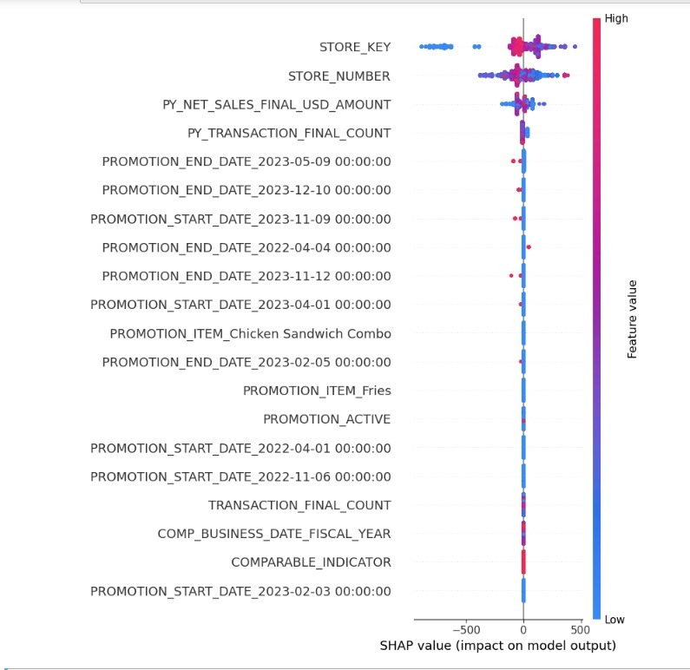
This SHAP summary plot visualizes the importance of each feature in predicting the target variable, in this case, the sales forecast.
Here's how to interpret the plot:
Feature Importance: The features are listed in order of importance, with the most important feature at the top. The importance is determined by the average magnitude of the SHAP values for that feature across all samples. In the plot, STORE_KEY and STORE_NUMBER are the most important features.
SHAP Value: The x-axis represents the SHAP value, which indicates the impact of the feature on the model's output. A SHAP value near 0 means that the feature has little effect on the prediction, while a larger absolute SHAP value indicates a stronger impact, either positive or negative. A positive SHAP value increases the prediction, while a negative SHAP value decreases it.
Feature Value: The color of the dots represents the value of the feature. Red dots represent higher feature values, and blue dots represent lower feature values.
For instance, a red dot on the right side indicates that a high feature value increases the prediction, while a blue dot on the left side indicates that a low feature value decreases the prediction.
Spread of SHAP Values: The spread of the dots along the x-axis indicates the range of SHAP values for the feature.
A widespread means the feature has a varied impact on the predictions across different samples, while a narrow spread indicates a more consistent impact.

